Slide 1
Database
Final
Team Violet
: Riders Management (food delivery)

Slide 2
Overview
01
02
03
04
05
Conceptual
design
mapping
normalization
Mysql Backup
QnA
What has changed compared to the midterm
represented by logical data modeling
Each table is propagated to other tables by relationship
Implemented with physical data modeling

Slide 3

Introduction
We figured out need and use and wrote conceptual design before
Following the midterms, go to the next step relational database that we’ve done so far

Slide 4
01
Conceptual design

Slide 5
What’s next?
Identifying Needs
Find and fix the logical weird part
Create a logical schema by mapping ERD
Normalization
Make a table and Implement with Mysql
Conceptual Design
Logical Data Modeling
Physical Data Modeling

Slide 6
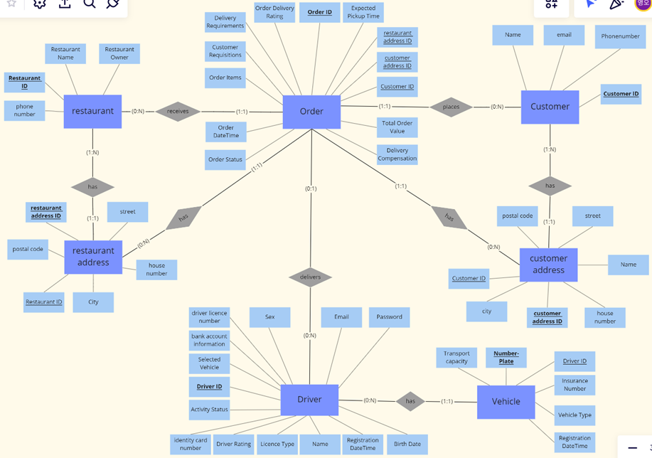
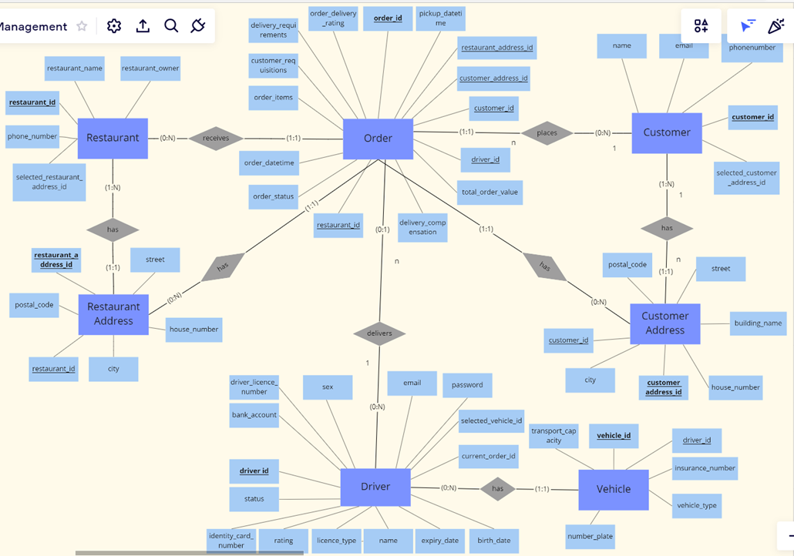
What’s changed?
midterm
updated version

Slide 7
Final version
It changed for each different purpose
Modified Entity : Order, Driver, Customer, Vehicle
It became simpler and more logical!
Ready to move on the next step

Slide 8
02
Mapping

Slide 9
What is mapping?
Identifying Needs
Conceptual Design
Logical Data Modeling
Physical Data Modeling

Slide 10
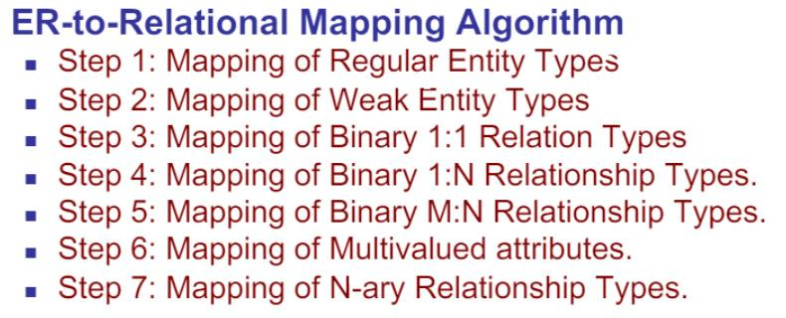

Slide 11
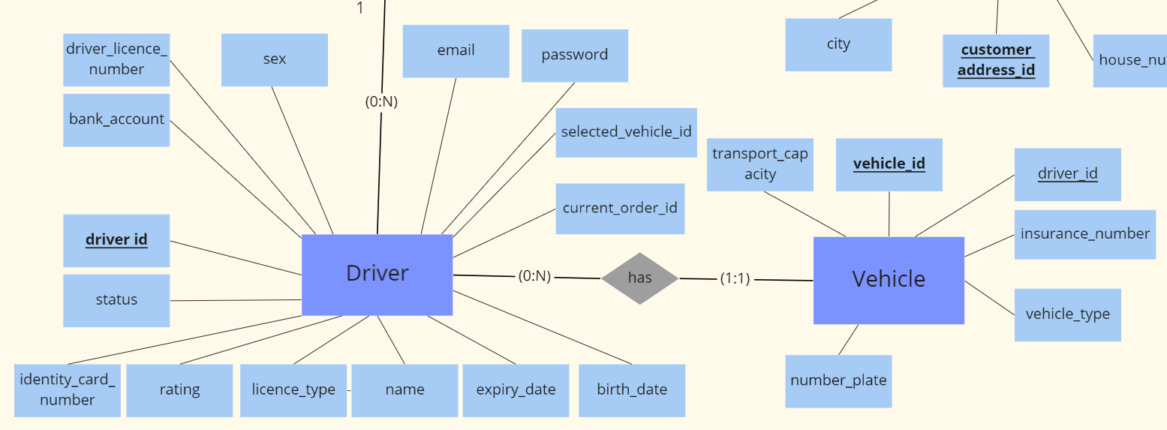
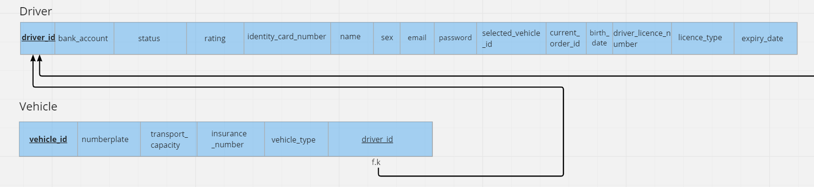
ERD Mapping(logical schema)

Slide 12
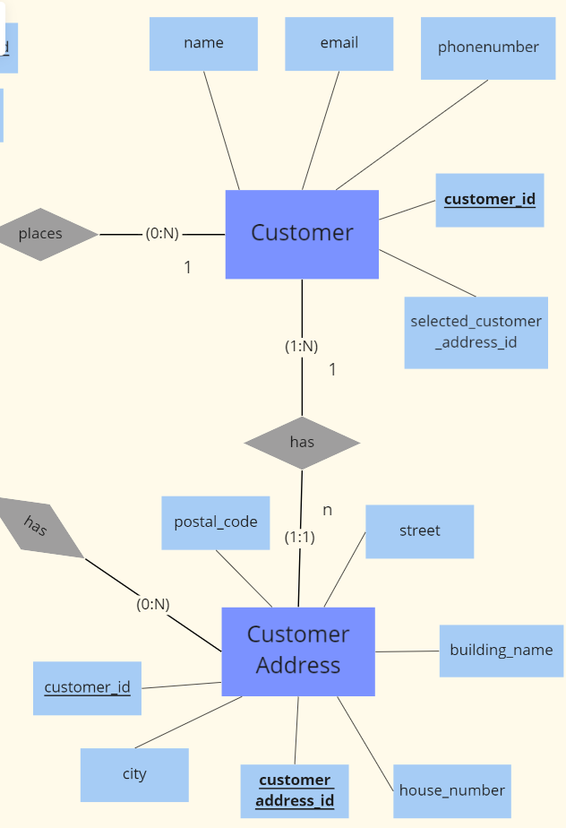
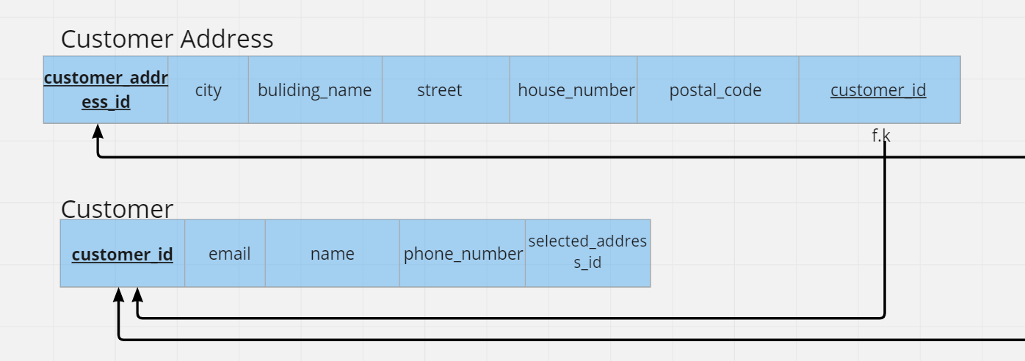
ERD Mapping(logical schema)

Slide 13
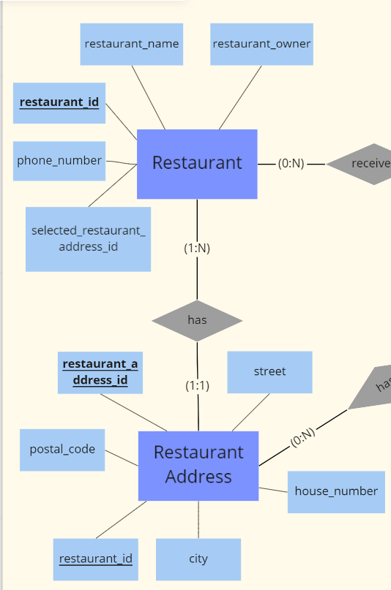
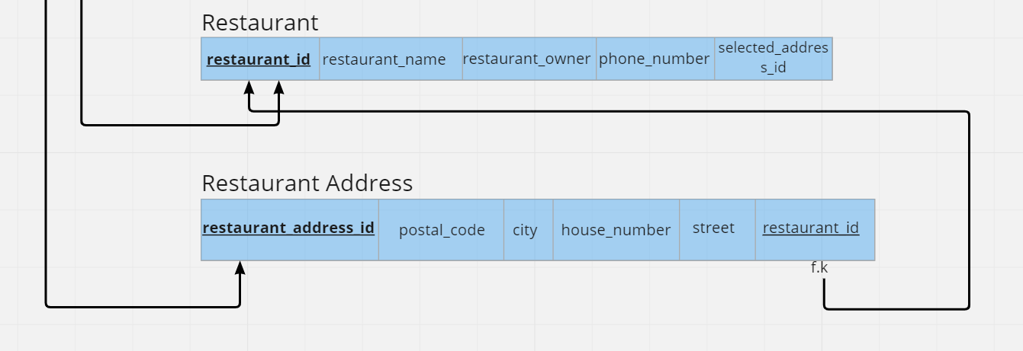
ERD Mapping(logical schema)

Slide 14
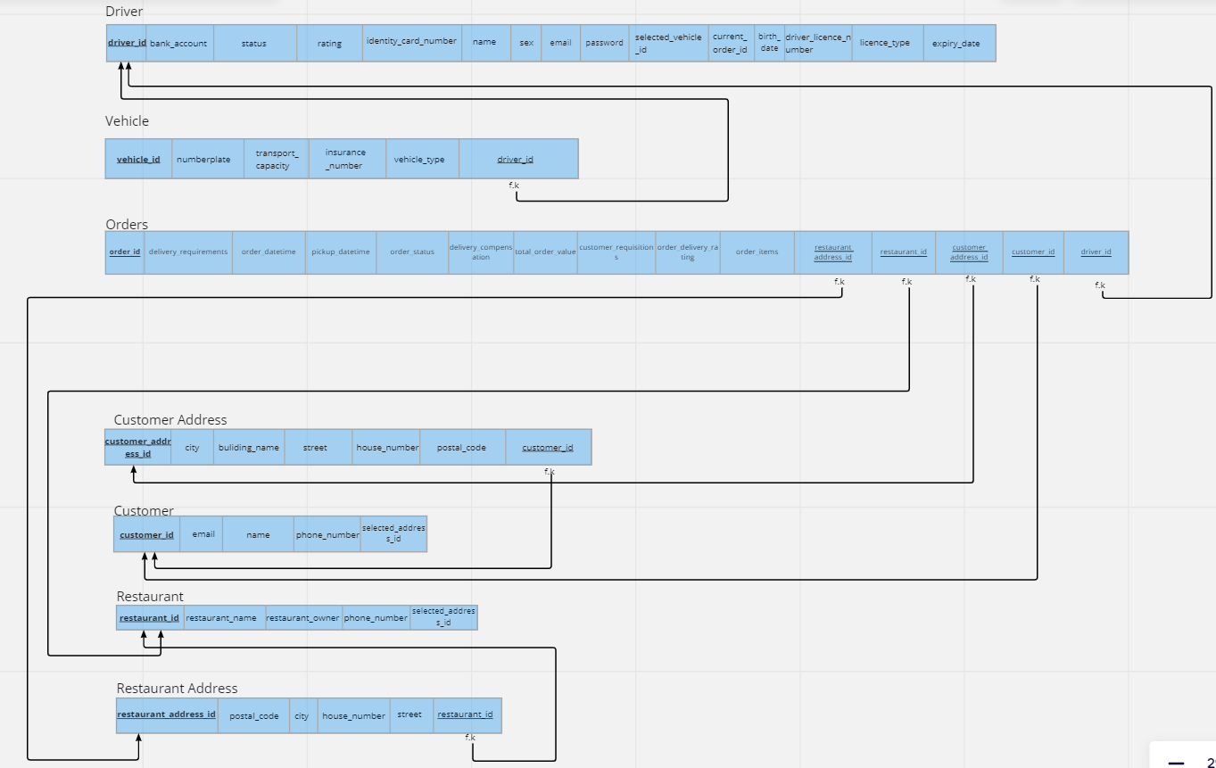
ERD Mapping(logical schema)

Slide 15
03
Normalization

Slide 16
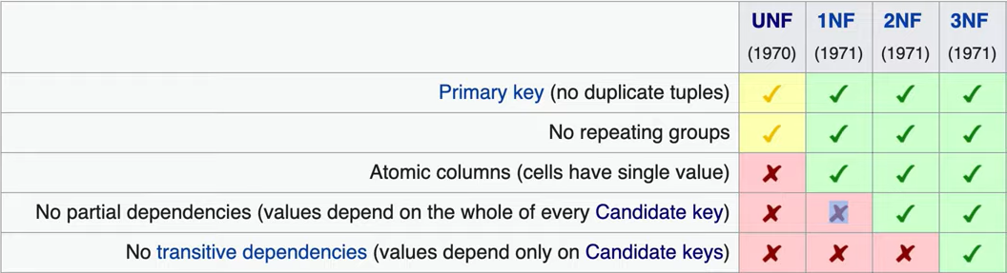
Normalization
Notes:
When we doing the 1nf It must satisfy the atomic value, which must have only one column value for each row. We solved this problem that we insert the data in our table. So it could be solved automatically.
2nf is two candidate keys violates the function dependency while pointing to the other attribute.These are the target of the 2NF. Before the 2NF, the table has to satisfy the 1NF.

Slide 17
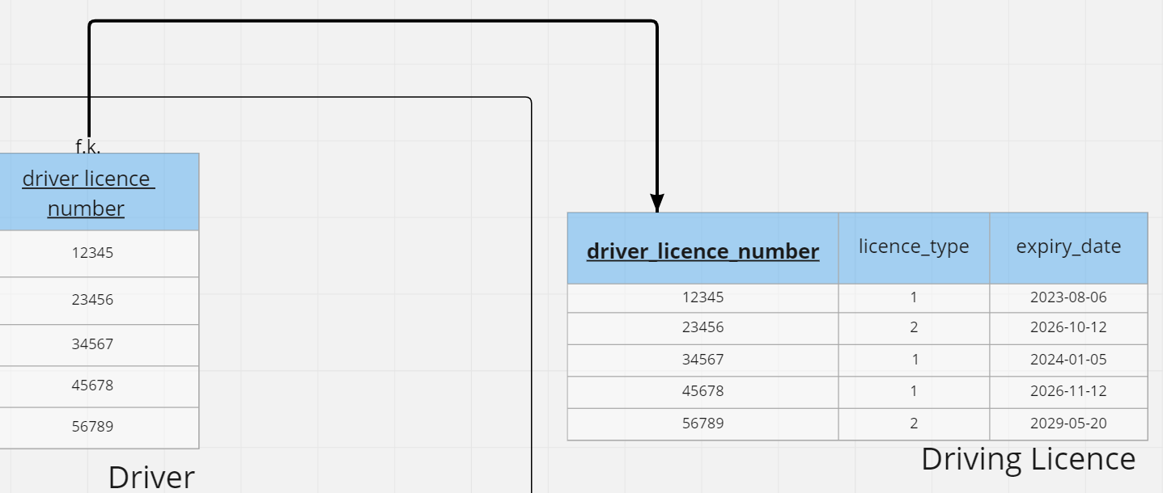
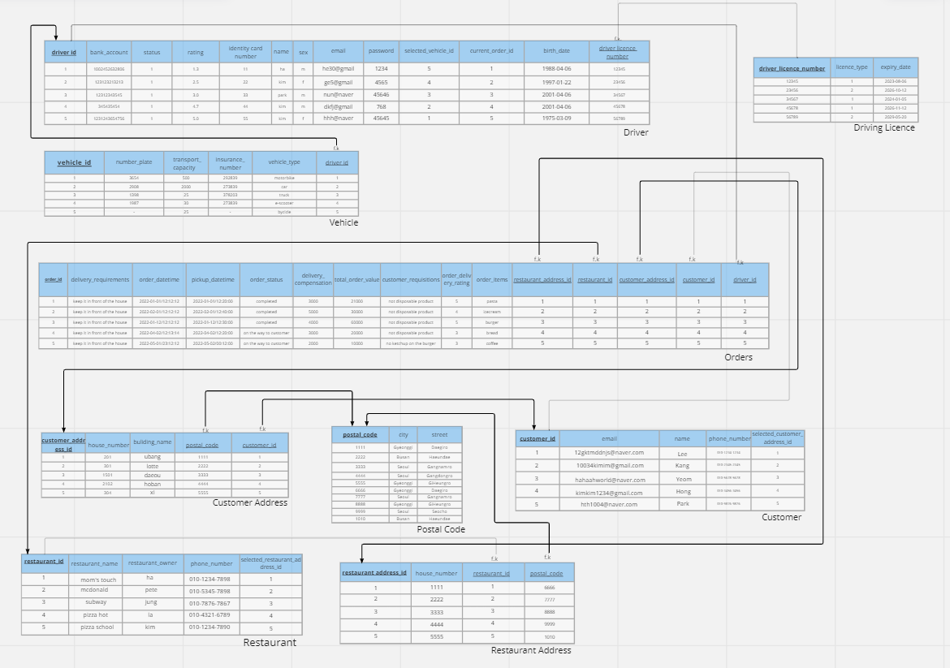
Normalization
Notes:
Transitive functional dependency

Slide 18
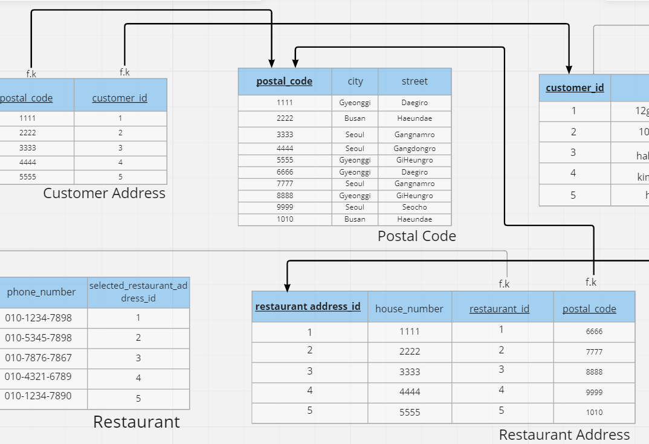
Normalization

Slide 19
Normalization

Slide 20
04
Mysql Backup

Slide 21
04
Identifying Needs
Work bench
Conceptual Design
Logical Data Modeling
Physical Data Modeling

Slide 22


Software Used
DataGrip
An IntelliJ based IDE that is fast and simple to create databases
MySQL Workbench
A Database IDE made by the creators of MySQL Oracle to simplify EER and ERD diagrams

Slide 23
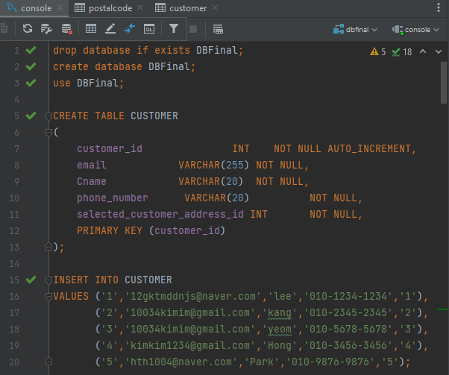
Implementation
To implement the database we coded it to prove that our database normalization is correct, with all of its foreign keys and connections and if the datatypes are correct.

Slide 24
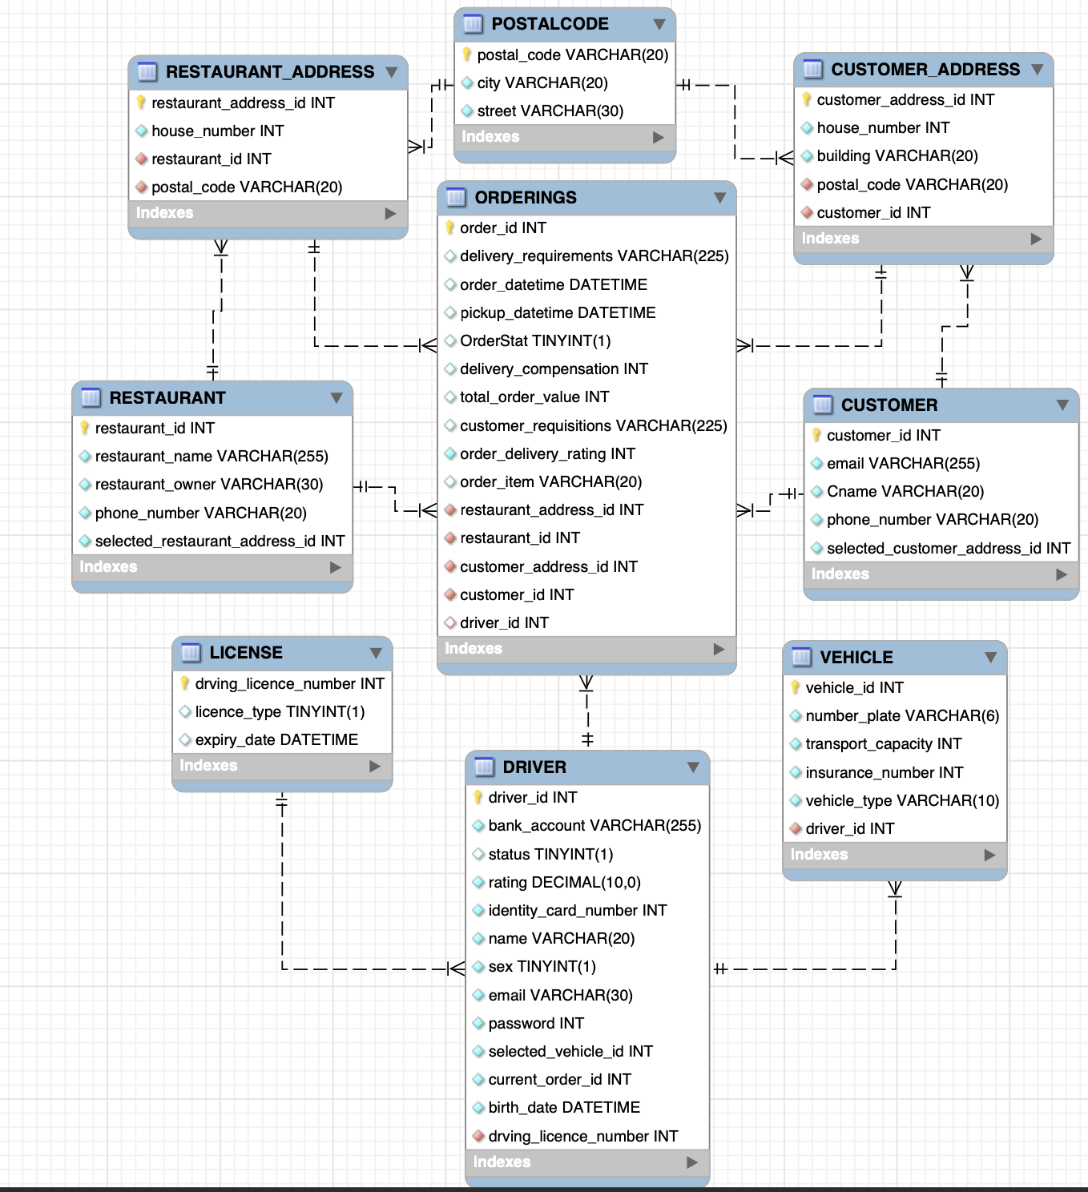
EER-Diagram

Slide 25
05
QnA

Slide 26
QnA
Do you have any questions?
Reference
관계형 데이터 모델링 (opentutorials.org)

